Slide 1
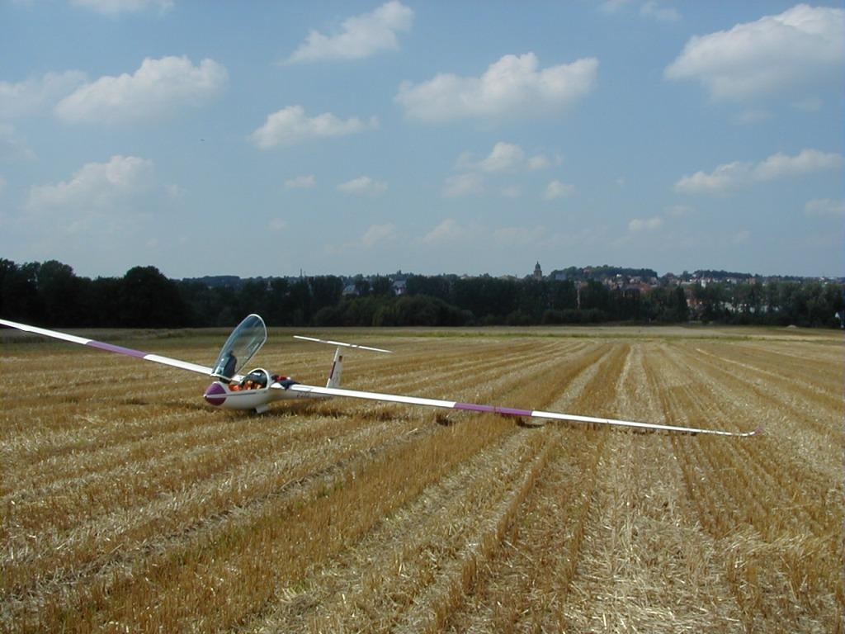
Cross-Country for Beginners Part 6: Landouts and Flight Analysis
Bill Elliott and Rand Baldwin

Slide 2
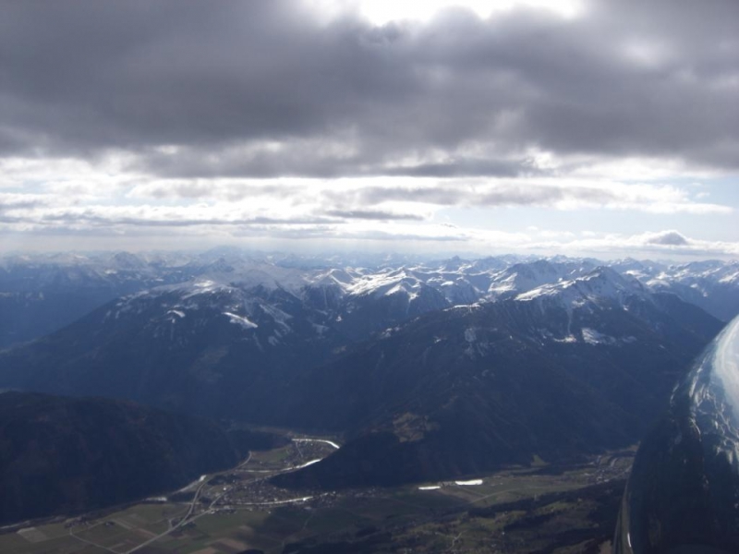
Six Week Agenda
Weather and Preparation (needed skills, glider & instrumentation, biological)
Thermals and Triggers
Climbing
Cruising and In-Flight Decision Making
Flight Computers and Final Glides
Outlanding and Post-Flight Analysis

Slide 3
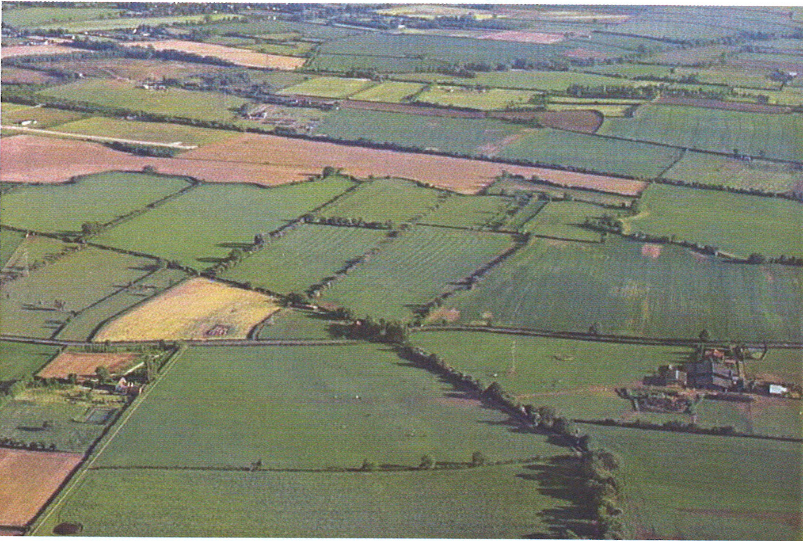
BGD, p. 94

Slide 4
Outlanding and Post-Flight Analysis

Slide 5
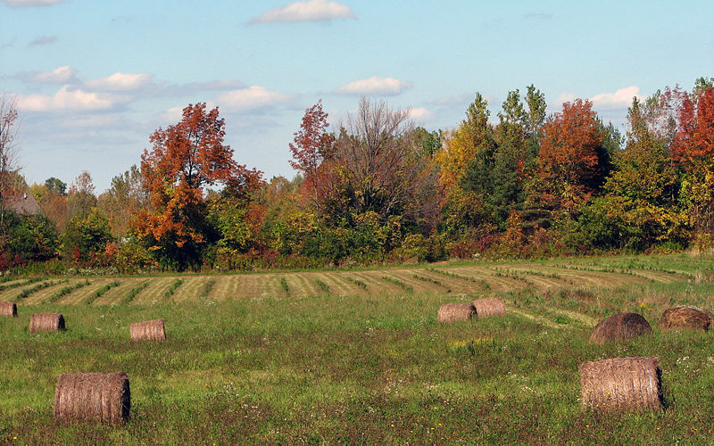
Reichmann, p. 60

